Slide 1
AGRICULTURE DATA ANALISY
PRESENTED BY:
ANSHU PANDEY
Email id- anshu18csu026@gmail.com

Slide 2
DATA COLLECTED BY:
KAGGEL
DATA.GOV.IN
MADE WITH –PYTHON

Slide 3
INTRODUCTION:
India’s agriculture is composed of many crops, with the foremost food staples being rice and wheat.
Indian farmers also grow pulses, potatoes, sugarcane, oilseeds, and such non-food items as cotton, tea, coffee, rubber, and jute.
Despite the overwhelming size of the agricultural sector, however, yields per hectare of crops in India are generally low compared to international standards.
Improper water management is another problem affecting India’s agriculture.
It is estimated that as much as one-fifth of the total agricultural output is lost due to inefficiencies in harvesting, transport, and storage of government-subsidized crops.
So lets us analyze more about the crop cultivation, cost invested, seasons for cultivation.

Slide 4
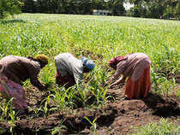
WHAT IS CROP INDEX????? SO LET US ANALYSIS CROP INDEX OF WORLD IN 2010………

Slide 5
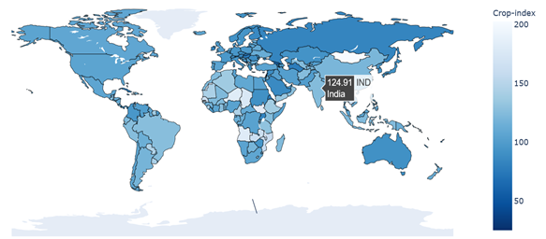
CROP INDEX OF WORLD IN 2010….

Slide 6
INFERENCES:
INDIA HAS 124.91 CROP INDEX THAT IS GOOD OVERALL.
CROP INDEX IS HIGHEST IN NIGER.
CROP INDEX IN AFRICA IS OVERALL MORE THEN OTHER CONTINENT

Slide 7
NOW DISCUSS AGRICULTURE IN INDIA…

Slide 8
MAJOR CROPS ANALYSIS.
we are going to analysis the first datafile.

Slide 9
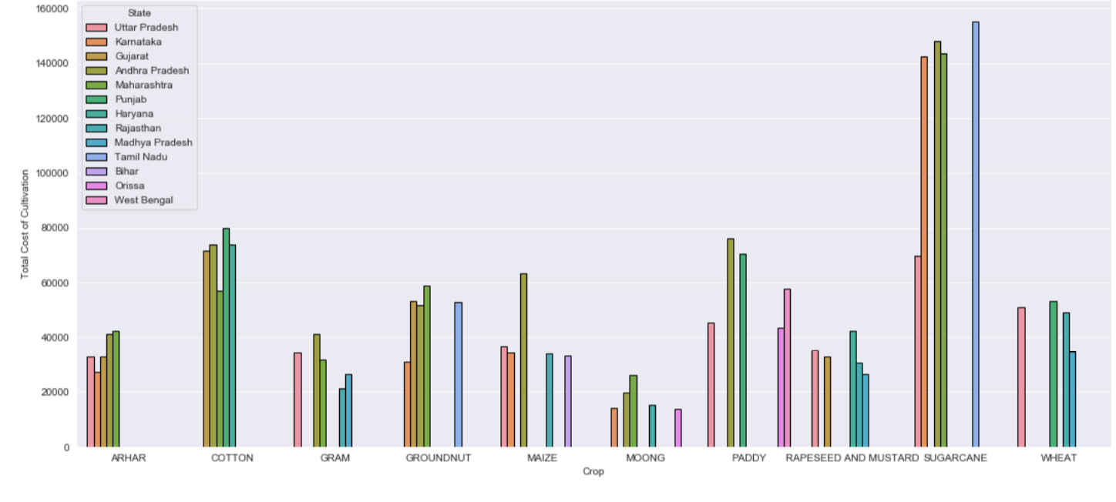
MAJOR CROPS COST OF CULTIVATION:

Slide 10
INFERNCES:
ARHAR,COTTON,GRAM,GROUNDNUT,MAIZA,MOONG,PADDY,MUSTARD,SUGERCANE,WHEAT ARE THE MAJOR CROPS THAT ARE CULTIVATED IN INDIA.
SUGERCANE IS THE MAJOR CROP THAT IS CULTIVATED THE MOST i.e. AROUND 1,60,000 RUPEES PER HECTOR.
U.P,TAMILNADU,MAHARAHSTRA,ANDHAR PRADSH,KARNATKA PRODUCES SUGERCANE.
SUGERCANE CULTIVATION COST IS HIGHEST IN TAMILNADU.
MOONG COST OF CULTIVATION PER HECTOR IS LOWEST i.e. AROUND 20,000 RUPEES PER HECTOR.

Slide 11
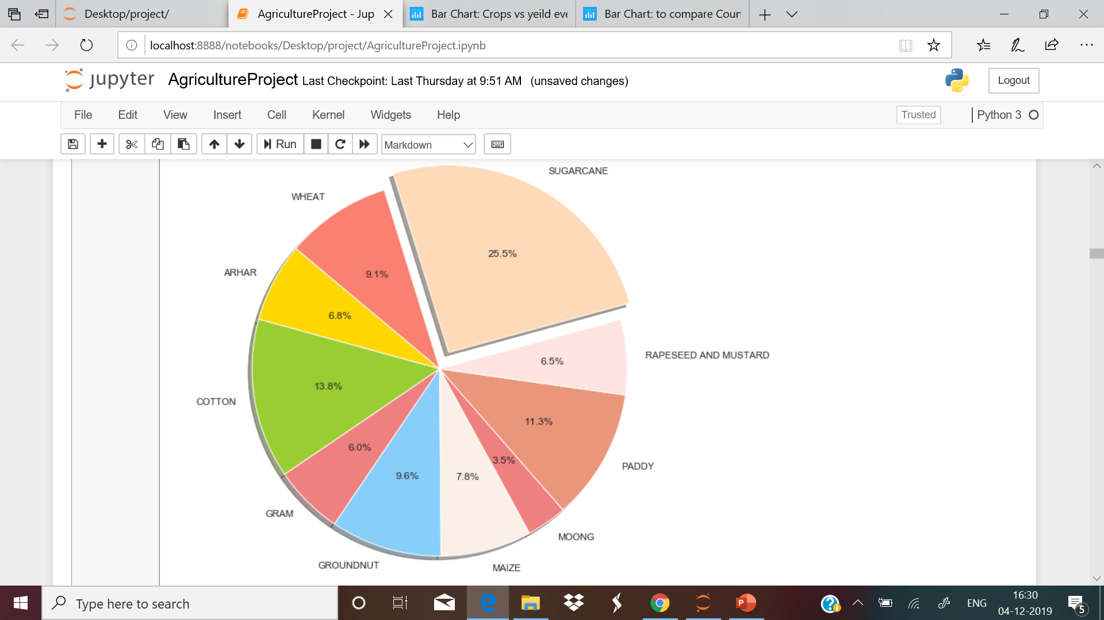
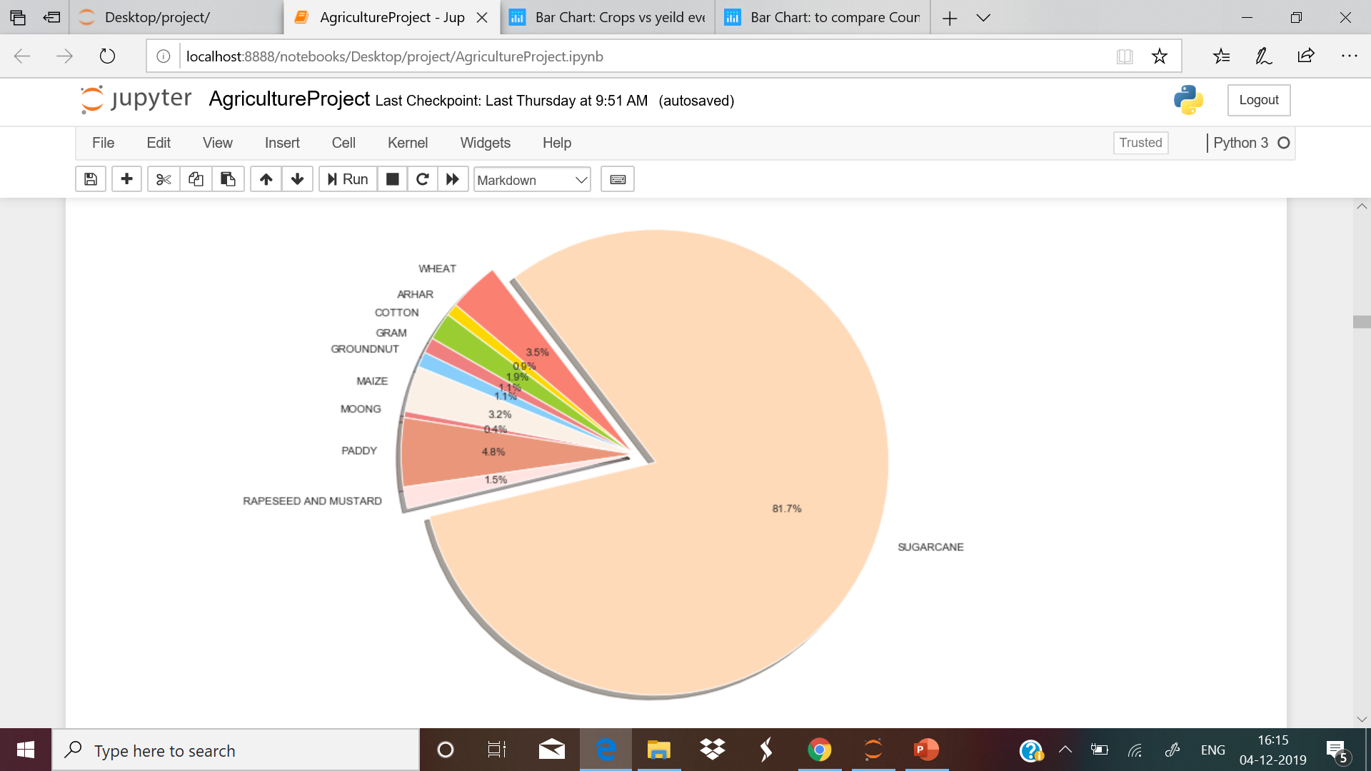
PIE CHART OF COST OF CUTIVATION AND YEILD :
COST OF CULTIVATION PER HECTOR
YEILD PER HECTOR

Slide 12
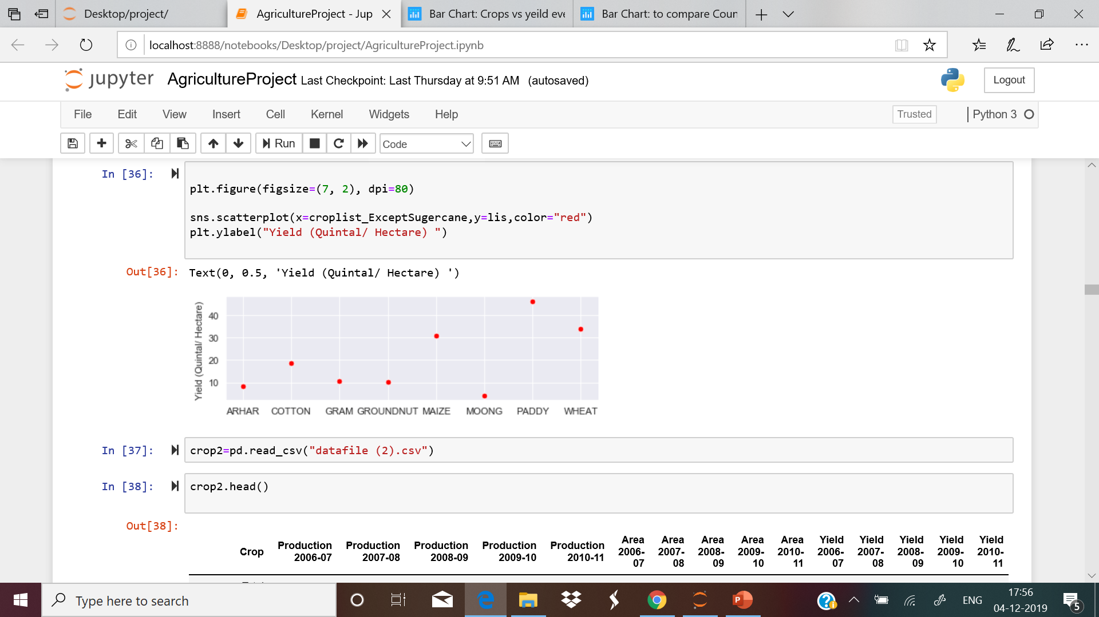
Yield of major crops.
PIE CHART DEPICTING THE YEILD/OUTPUT OF MAJOR CROPS……..
INFERNCES:
Yield Is the Output Of A Crop Per Unit Area Of Land Cultivation.
YIELD OF MOONG IS 0.4% LOWEST OF ALL.
WE APPLY 25% OF COST IN CULTIVATION OF SUGERCANE BUT ITS YEILD IS 81% WHICH IS GREATEST OF ALL THE YEILD OF ALL THE CROPS.
YEILD OF PADDY IS 40 QUINTAL / HECTOR.
AFTER SUGERCANE ,PADDY IS THE SECOND MOST YEILDED CROP.IN CASE OF PADDY WHAT WE INVEST AND WHAT WE GET IS BALANCED.
FROM THIS 2 PIE CHART WE CAN INFER THAT COTTON ,GROUNDNUT ,ARHAR WE INVEST A ALL BUT IN TIME OF PRODUCTION THEY ARE THE LEAST.

Slide 13
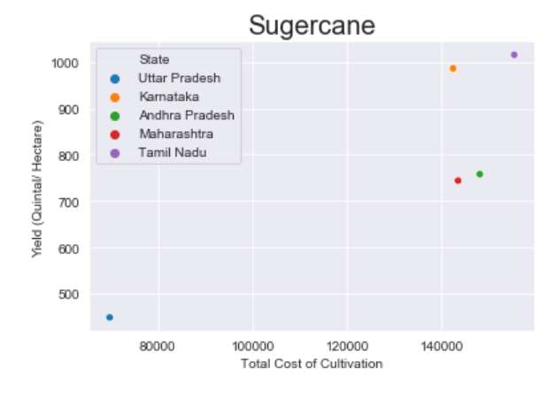
AS SUGERCANE IS THE OF THE HIGHEST YEILD AND WE INVEST A LOT ON THE SUGERCANE SO LET US ANALYSIS DATA OF SUGERCANE:
IN TAMILNADU BOTH TOTAL COST OF CULTIVATION AND YEILD IS HIGHEST .
2. BUT IN THE CASE OF MAHARASHTRA AND ANDHRA PRADESH TOTAL COST OF CULTIVATION IS MORE I.E WE INVEST A LOT IN THIS STATE IN CULTIVATION OF SUGERCANE BUT OUTPUT IS LESS NOT MEETING OUR EXPECTION

Slide 14
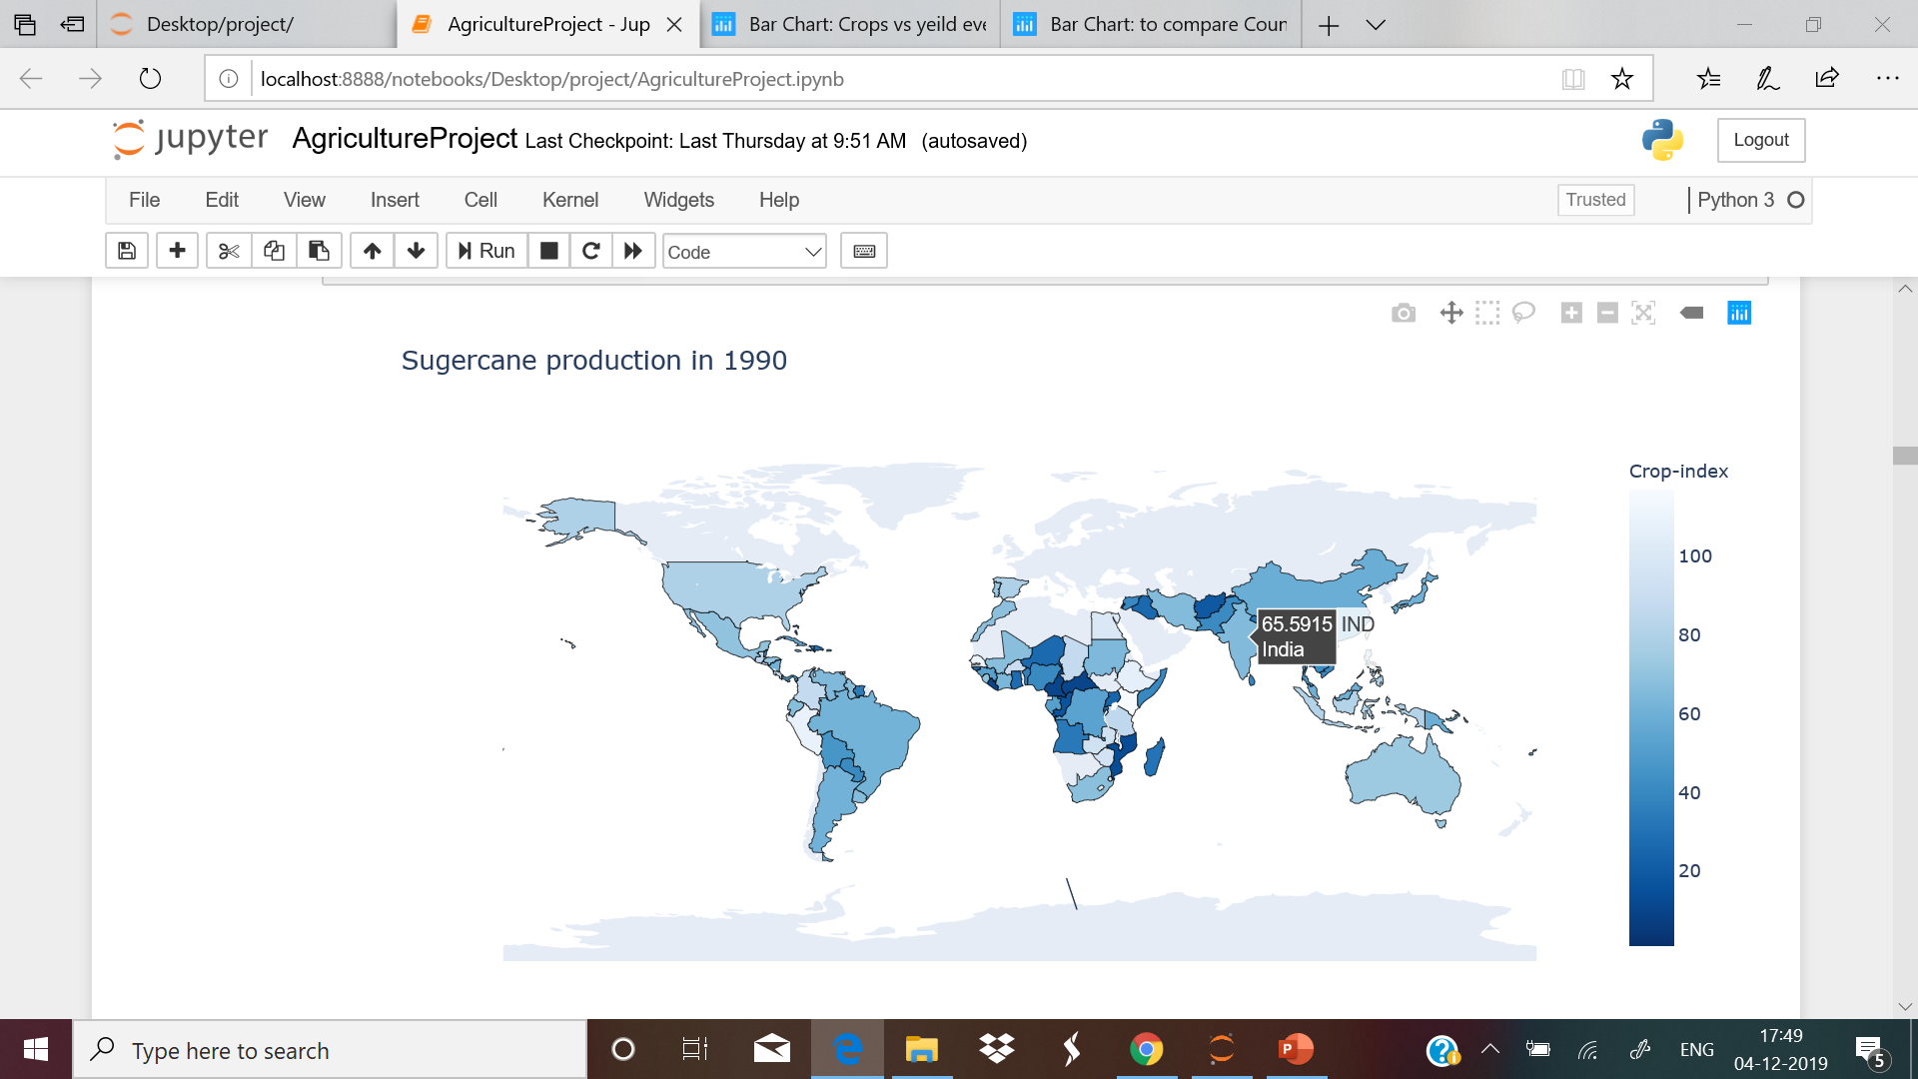
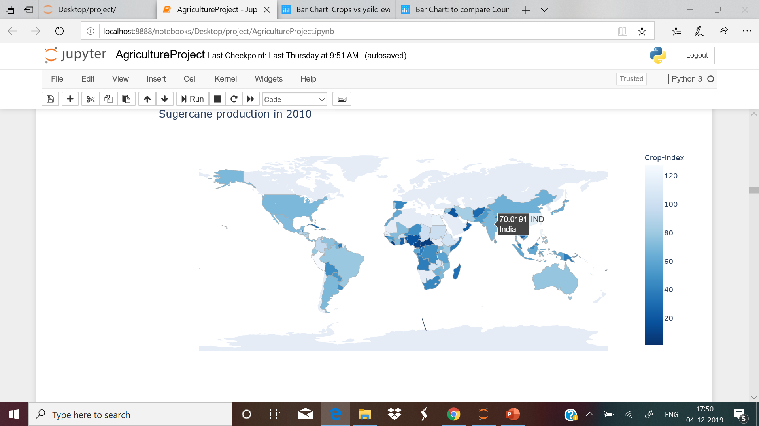
World map For Production Of Sugarcane.
production
Production
We have increased the production of sugarcane from 1990 to 2010 from 65.59 per hector to 70.01 per hector.

Slide 15
KNOW WE ARE GOING TO ANALSIS THE CROP TREND OF ALL THE CROP PRODUCED BY INDIA.
IN THIS DATAFILE WE HAVE AREA, PRODUCTION ,YEILD FROM YEAR 2006-2010.
Production in 2006-07 is 9278.399999999998 area per hector.
Production in 2007-08 is 10044.600000000004 area per hector.
Production in 2008-09 is 9897.400000000001 area per hector .
Production in 2009-10 is 9556.2 area per hector .
So Max production is in 2007-08 of ----> 10044.6 area per hector.

Slide 16
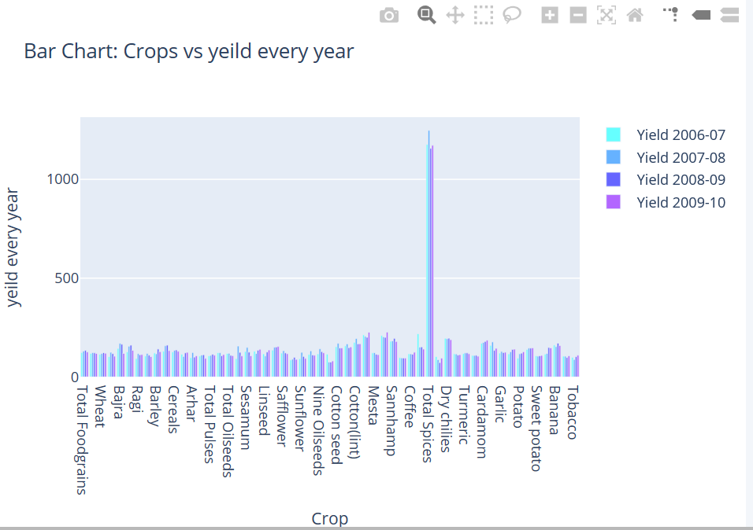
Crop v/s Yield Per Year To See The Trend.
https://plot.ly/~anu2472000/115/#/

Slide 17
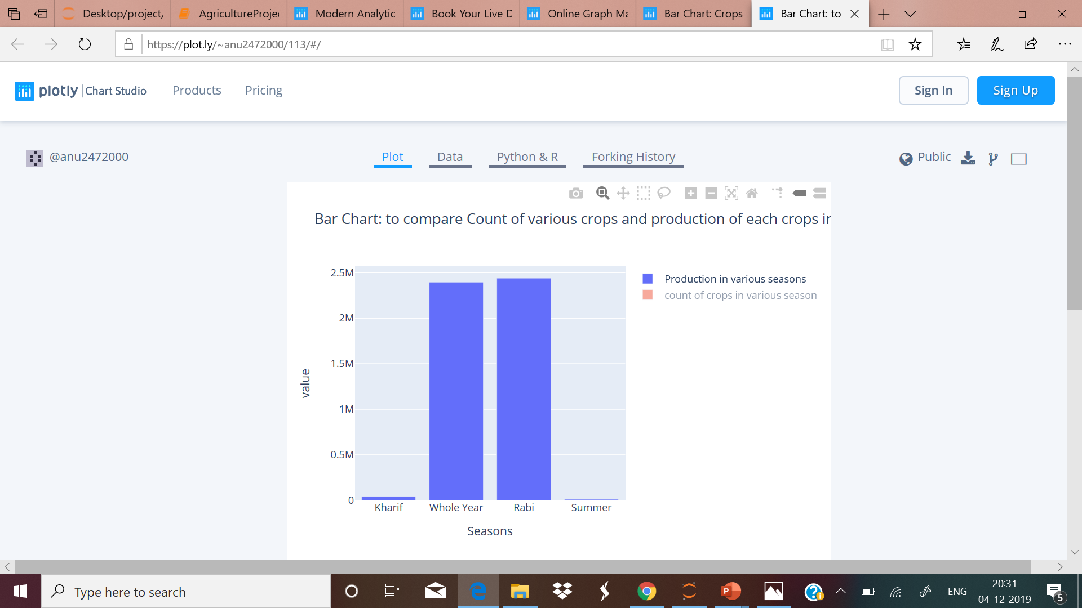
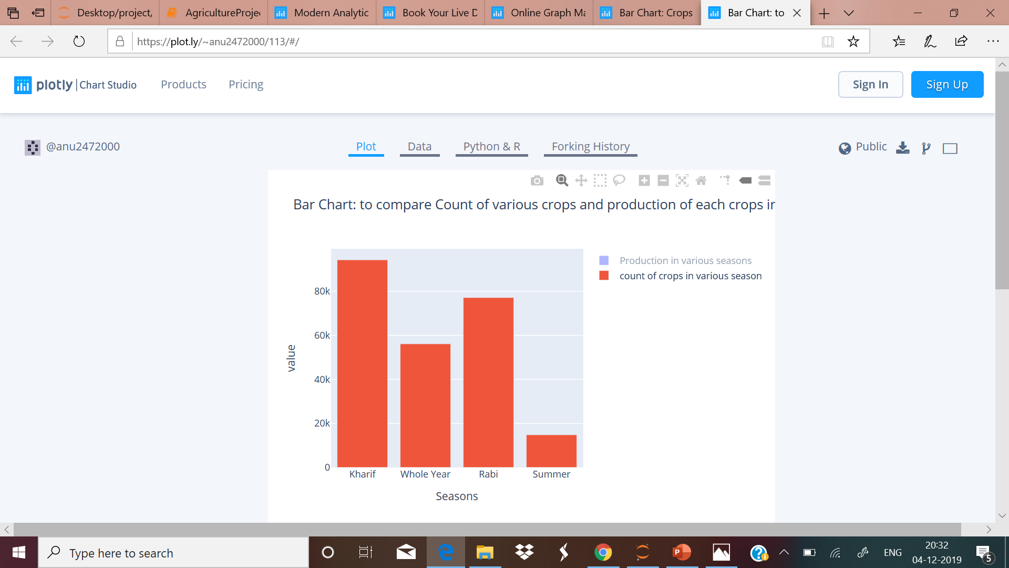

Slide 18
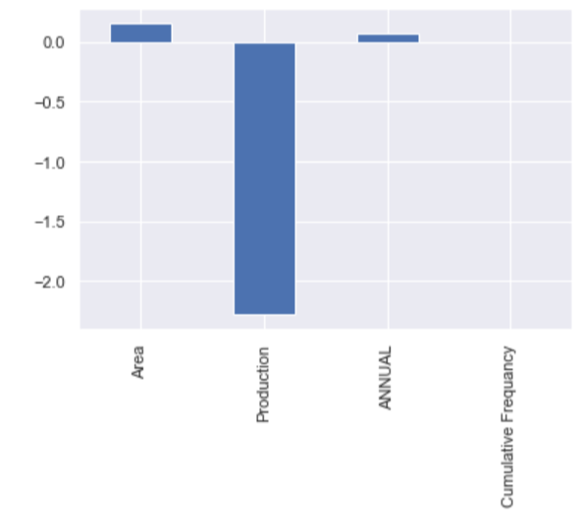
Skewness::>>> Area 0.151162 Production -2.281900 ANNUAL 0.065117 Cumulative Frequency 0.001771
The Interquartile Range of Production is: 88.25 per hector
The Interquartile Range of Annual Rainfall is: 0.36970315310677826 units

Slide 19
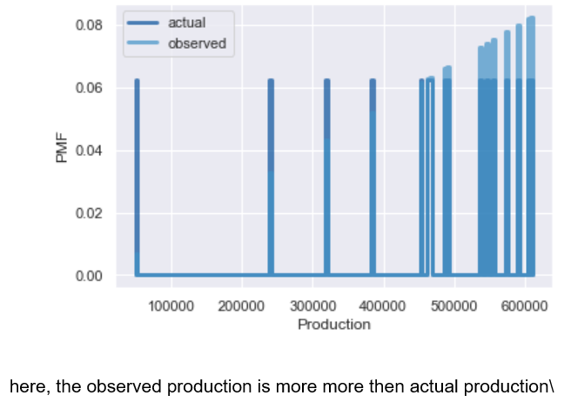
Actual mean 460690.3775
Observed mean 506389.8988397814
9.917% data of production is biased.

Slide 20
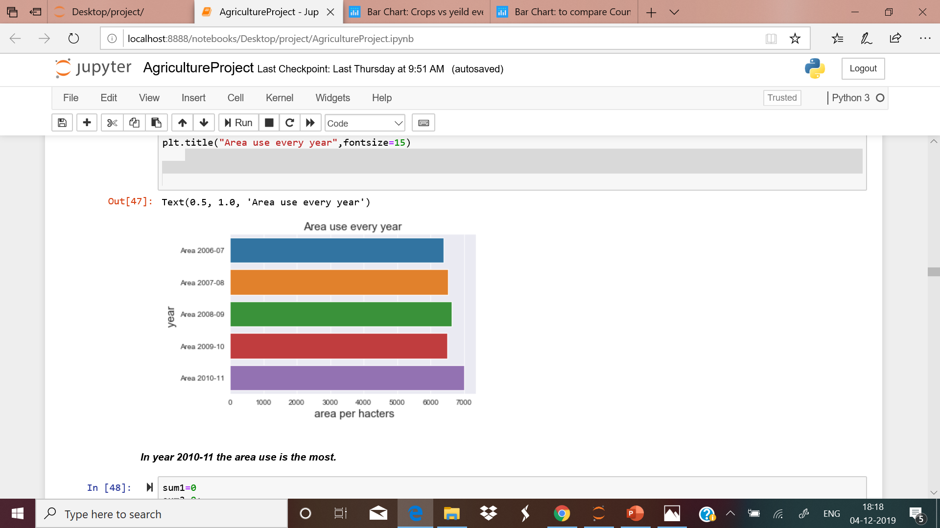
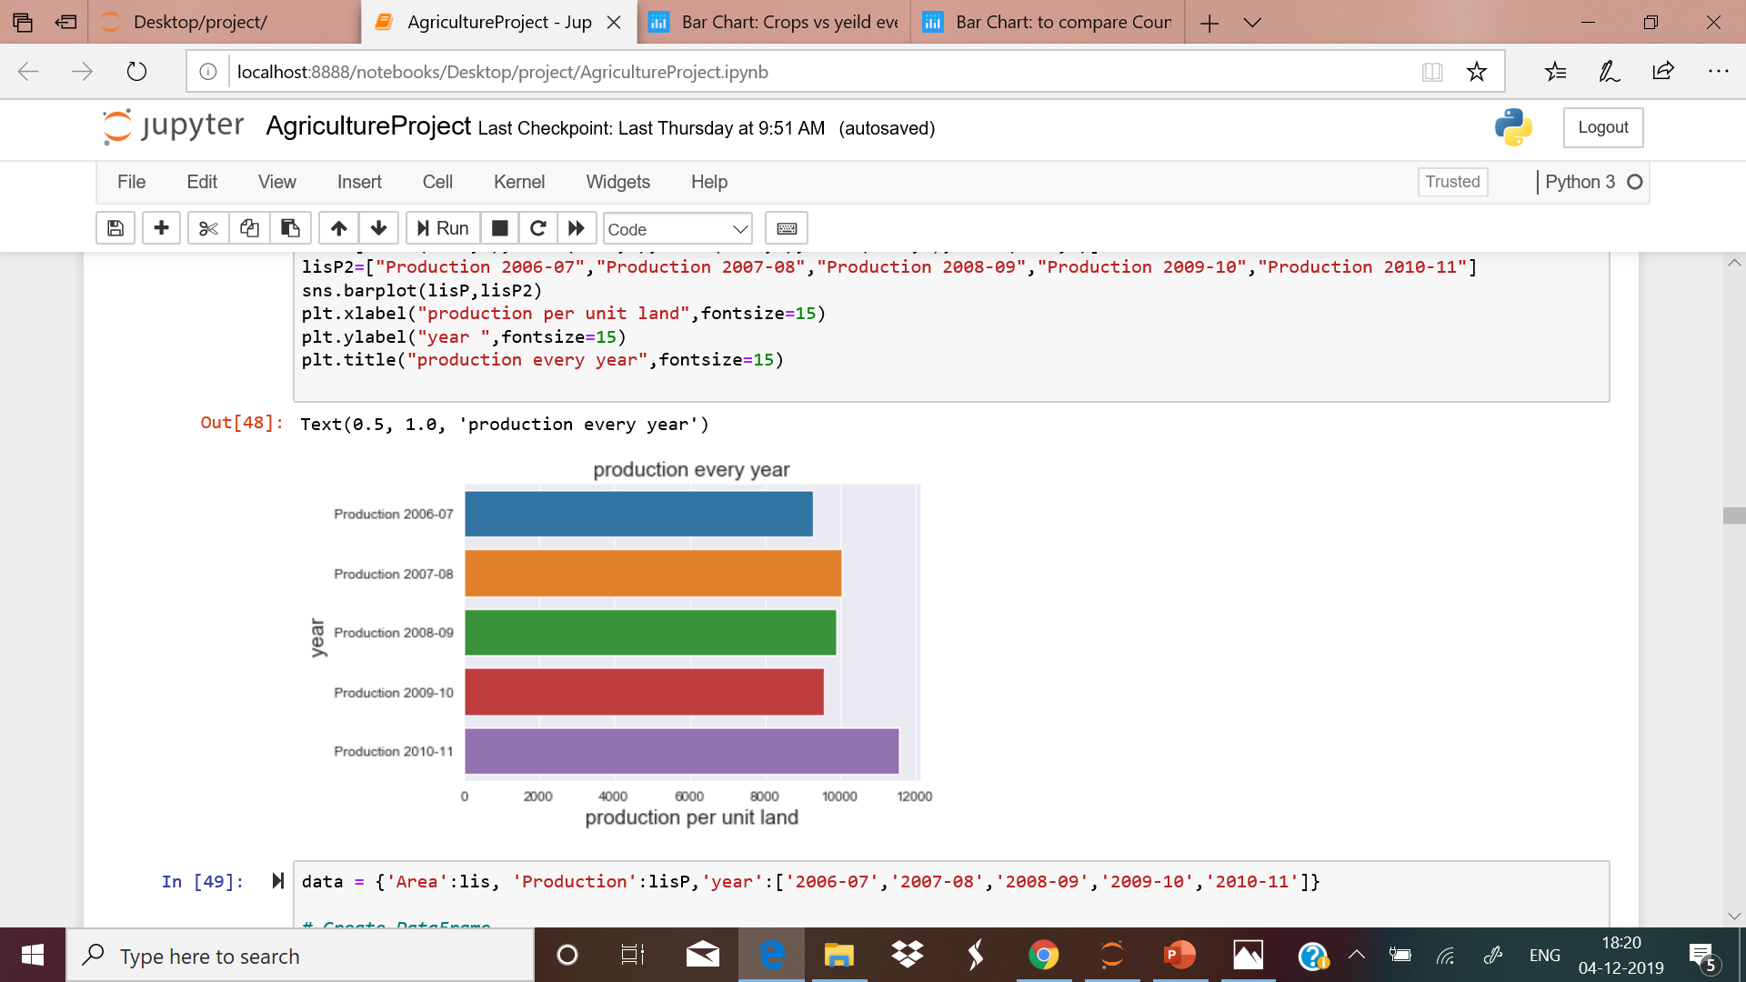
TO SHOW THE YEILD OF EVERY CROP:
https://plot.ly/~anu2472000/109/#/
AREA USED PER YEAR.

Slide 21
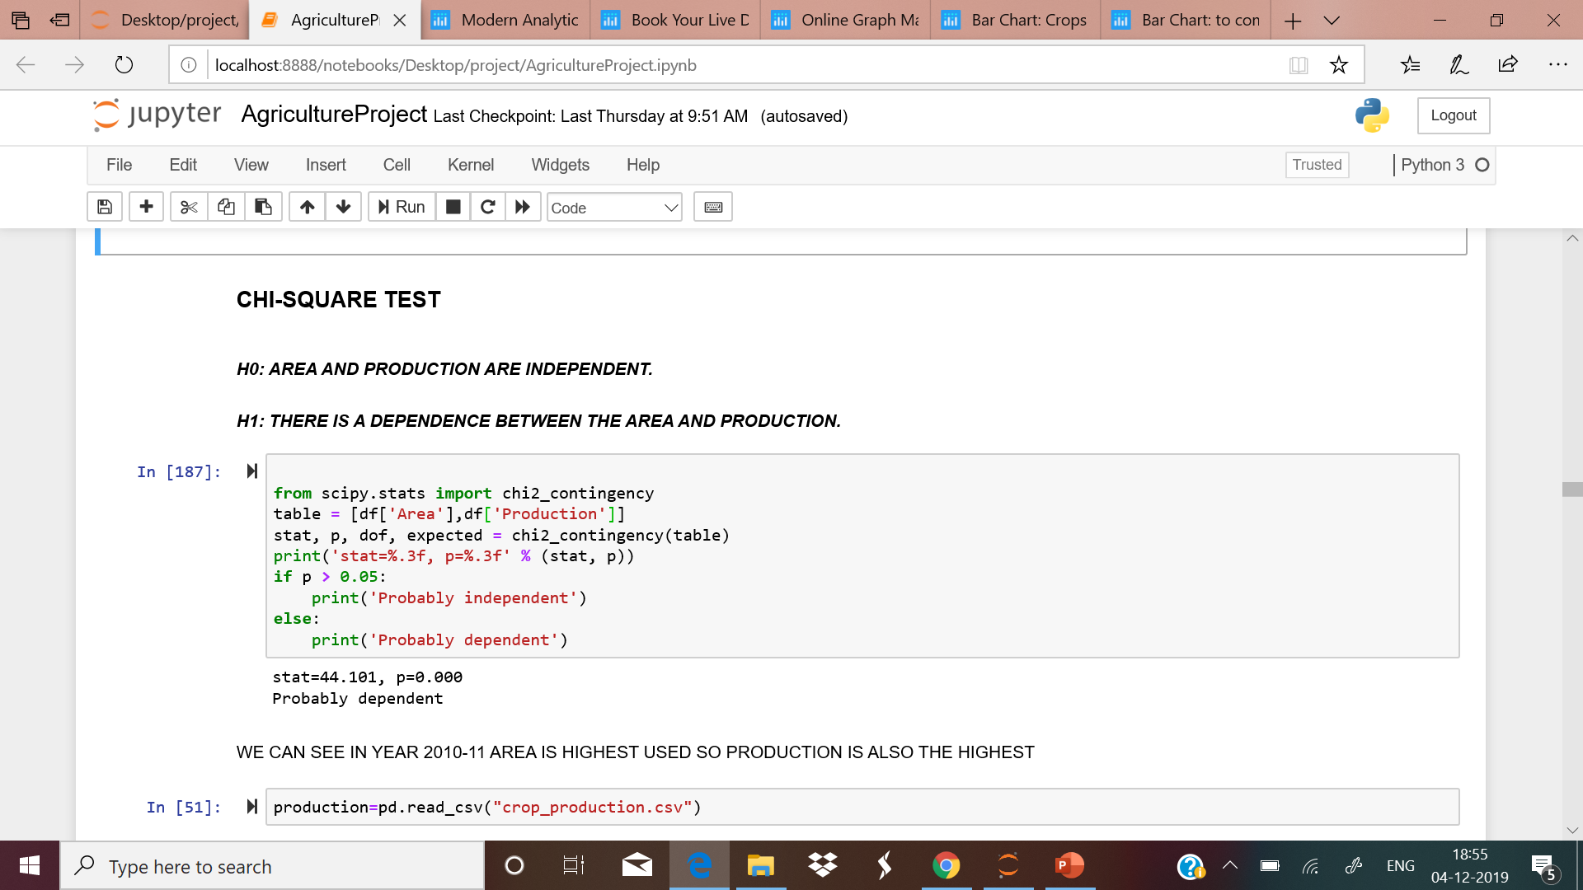
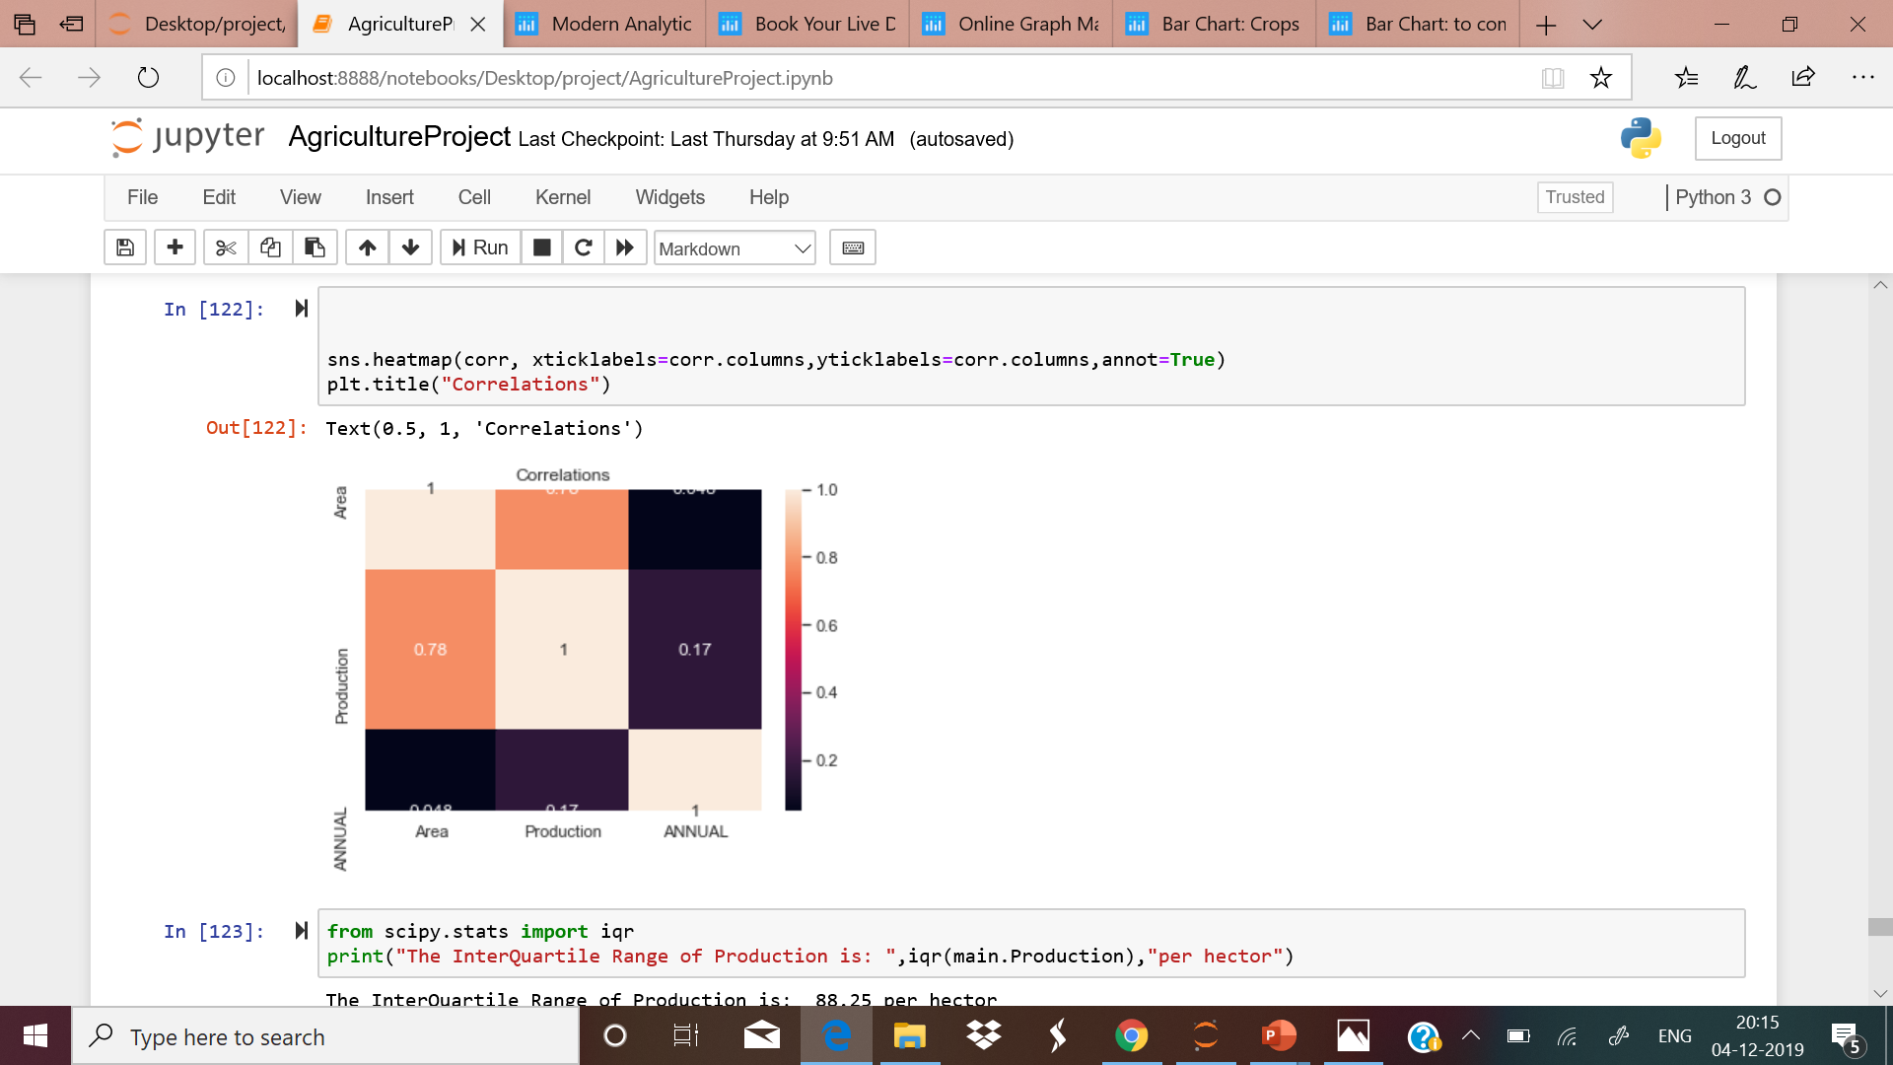
WE HAVE CONFORMED THAT IS THERE ANY DEPENDENCY B/W PRODUCTION AND AREA OR NOT::
WE HAVE USED CHI-SQUARE TO PROVE THAT THERE IS A DEPENDENCE B/W AREA AND PRODUCTION.

Slide 22
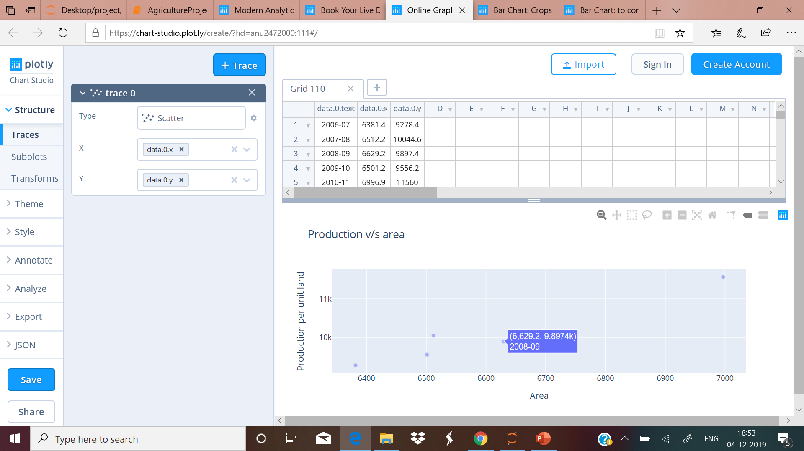
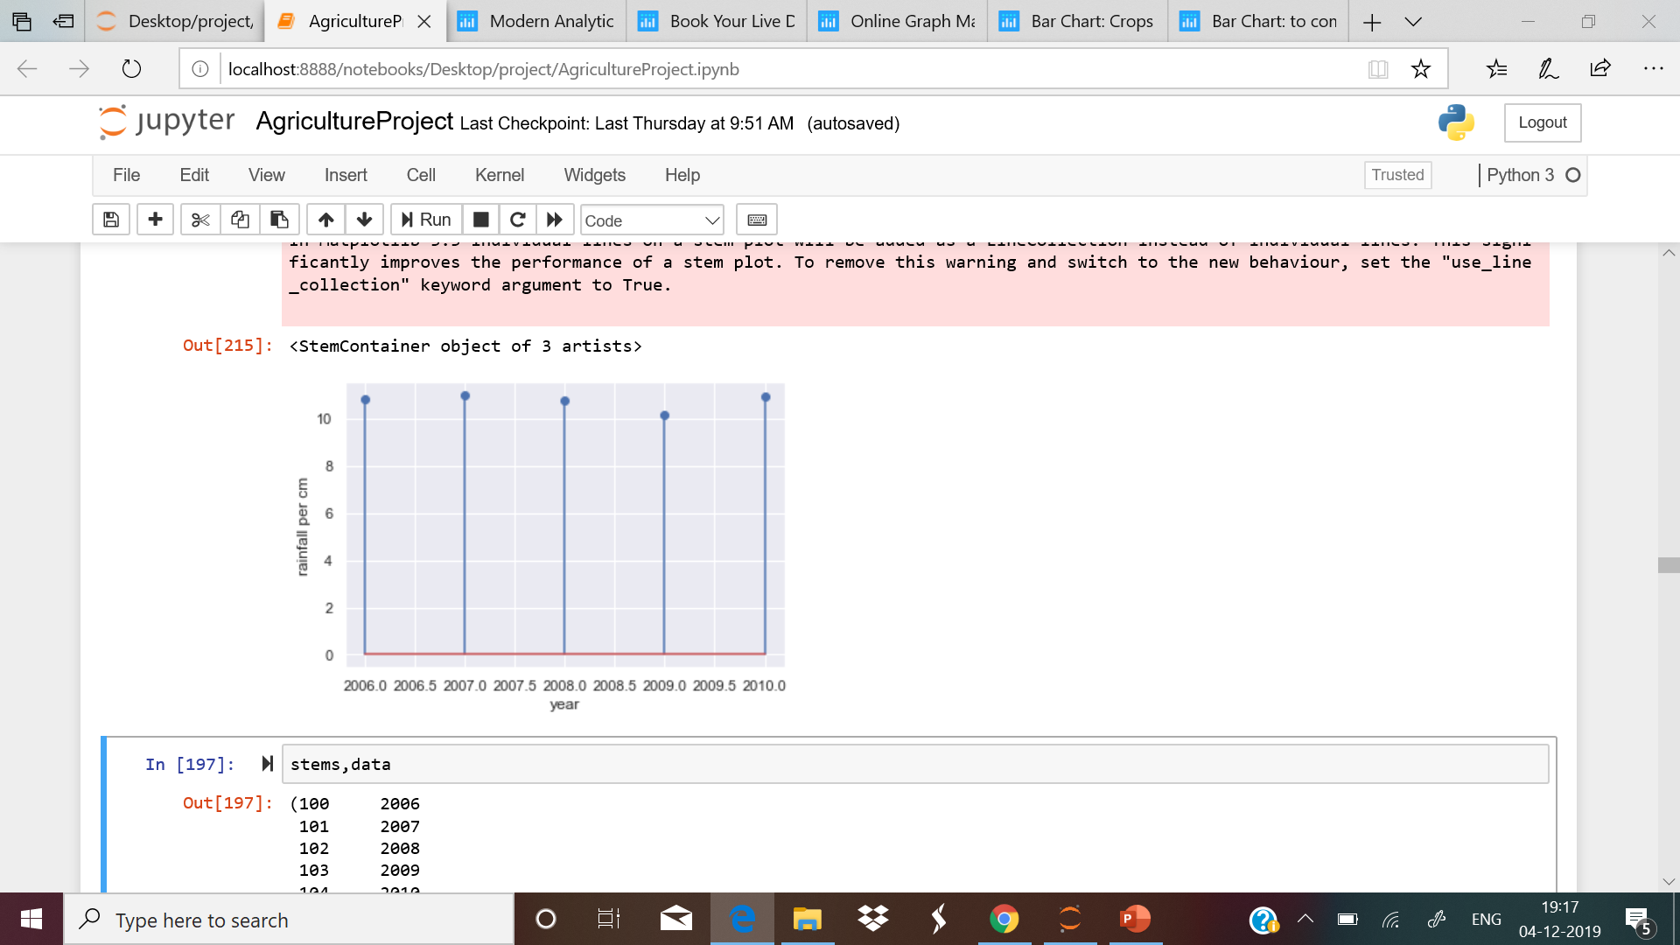
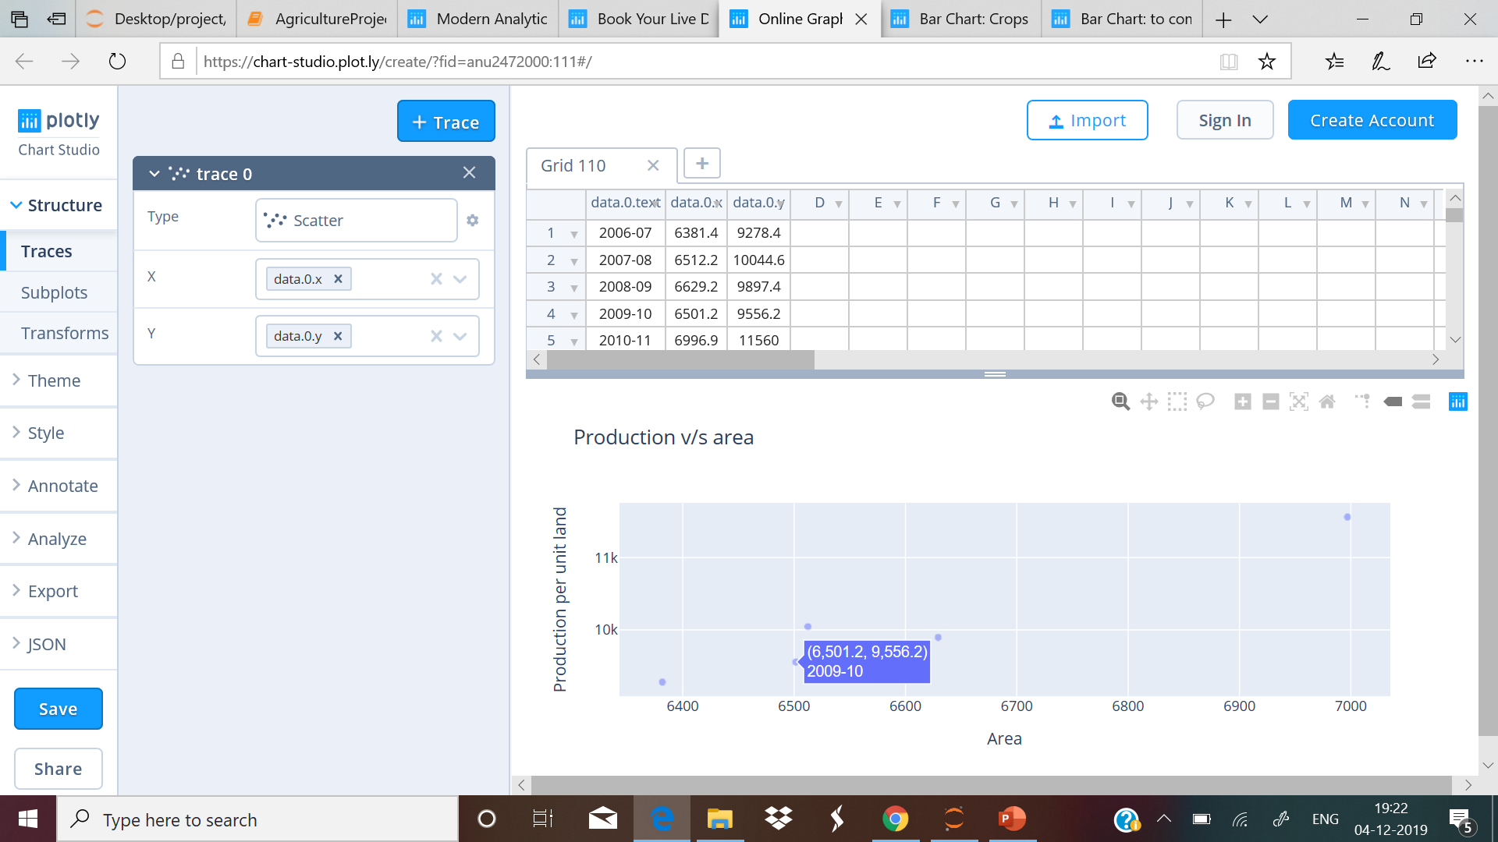
https://chart-studio.plot.ly/create/?fid=anu2472000:111#/
Scatter plot b/w Production and area every year
BUT WHY THERE IS LOW PRODUCTION IN 2008-09 Despite INCREASE IN AREA????
There is a decrease of rainfall in 2008-2009 so there is a decrease of production in 2008-09 despite of increase in area.
Here, we can see the annual rainfall in year was all less .
Production is also dependent on rainfall

Slide 23
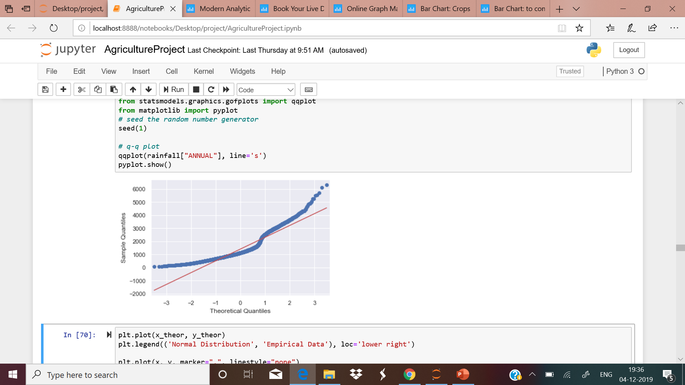
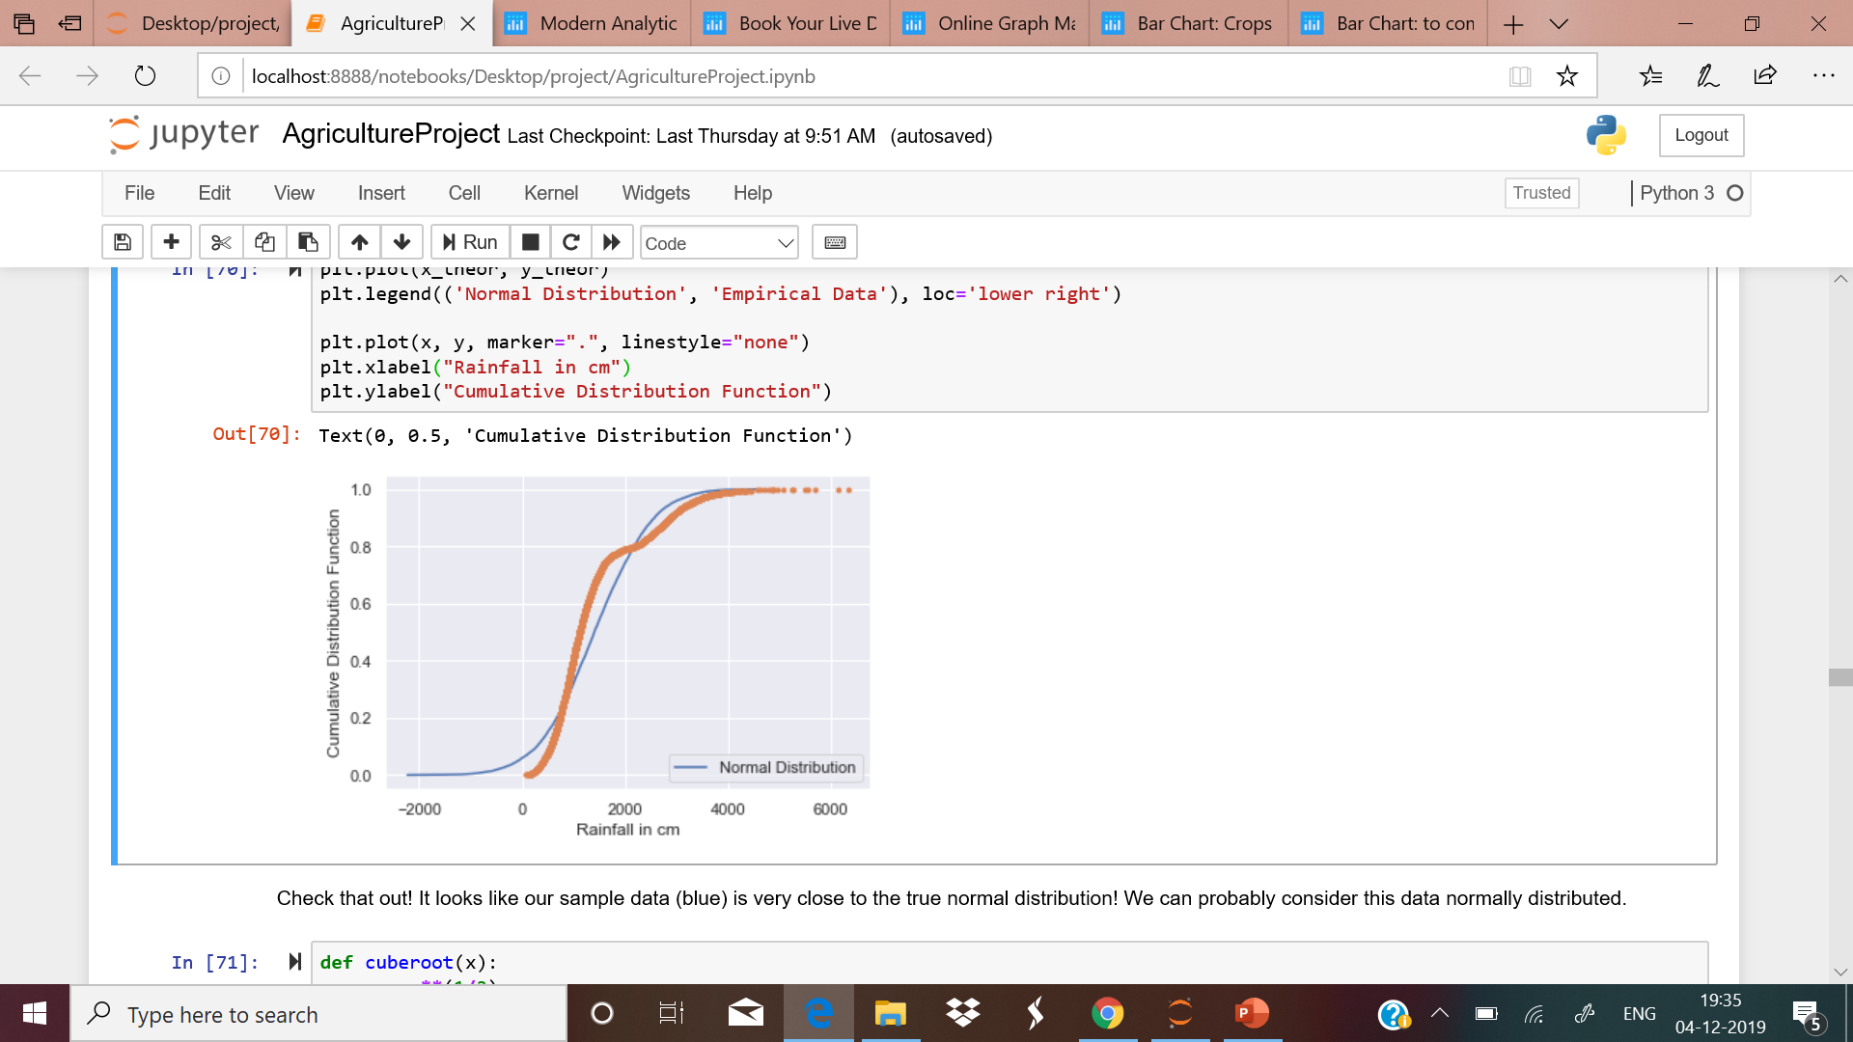
We have analysis our rainfall data is it normally distributed or not and how confident are we about our data.
We have done test for this data -Q-Q Plot
quantile-quantile Plot
Empirical Cumulative Distribution Function
Probability of getting rainfall less then equal
to 1133.10 cm is: 1.0
i.e. Every year rainfall of 1133cm rainfall is obvious .
This is mean and standard deviation of rainfall(10.755, 2.2307)
Probability of Rainfall less then 200 cm is 0.09
There is 9.01% of chance of having rainfall equal or less then 200 cm rainfall

Slide 24
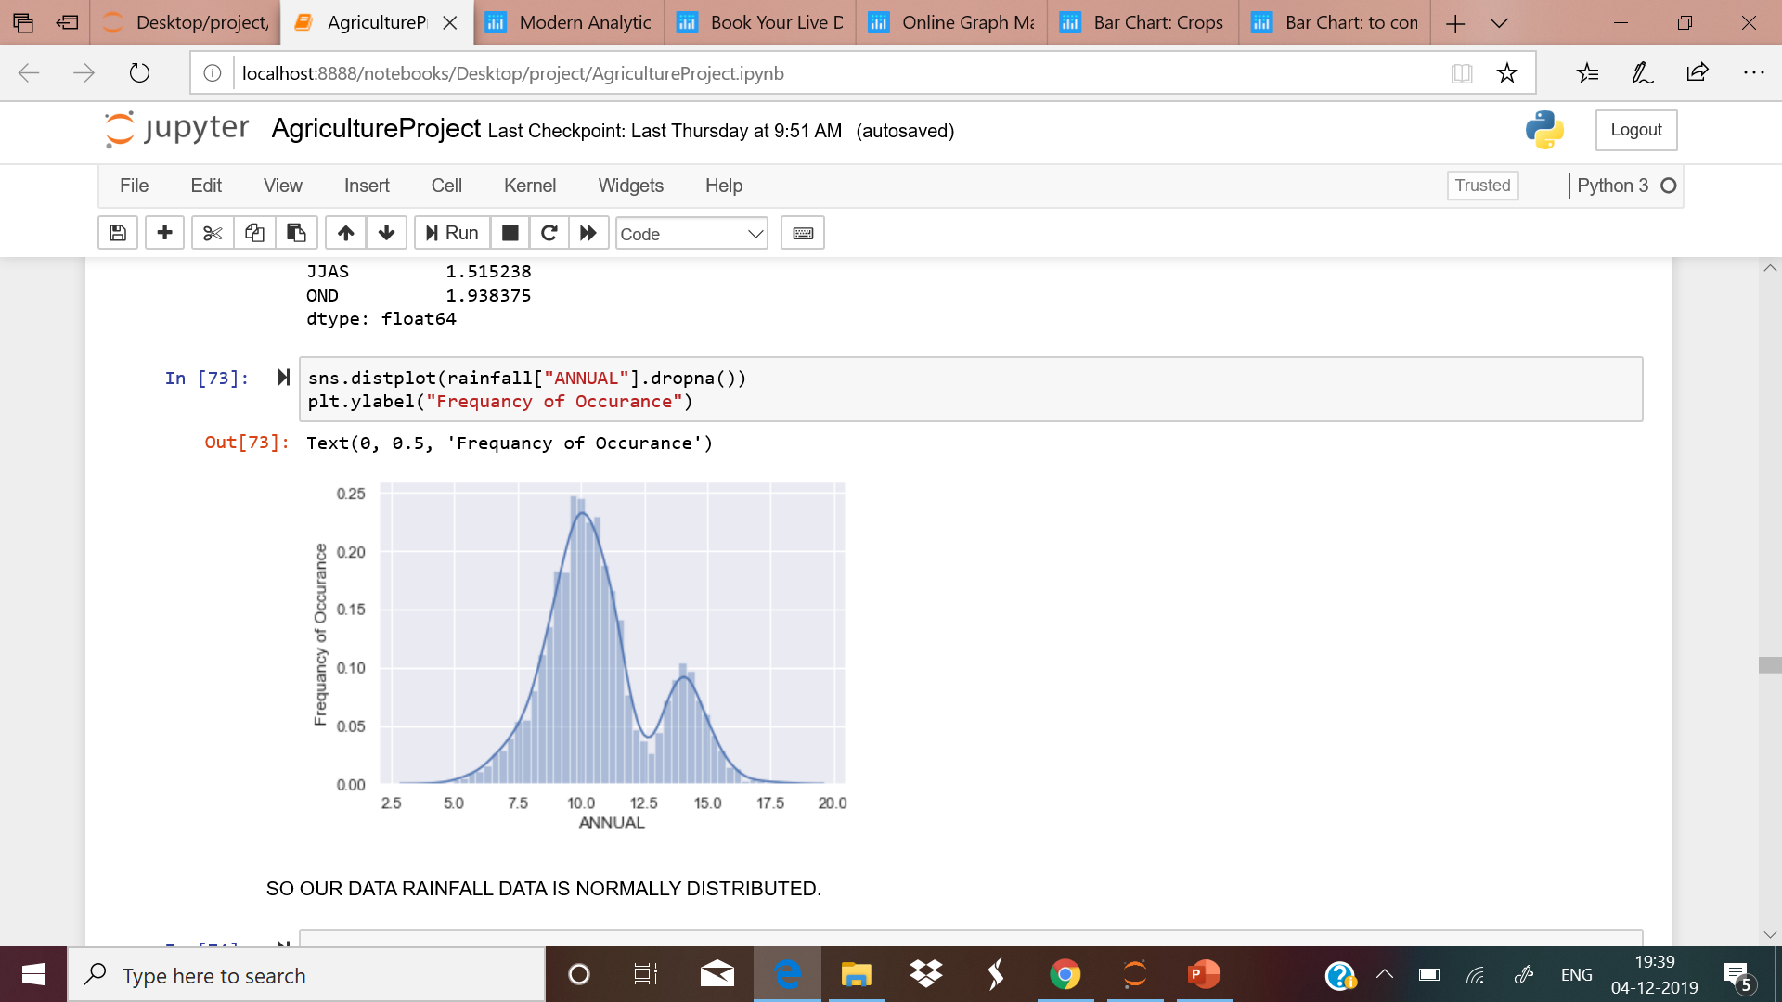
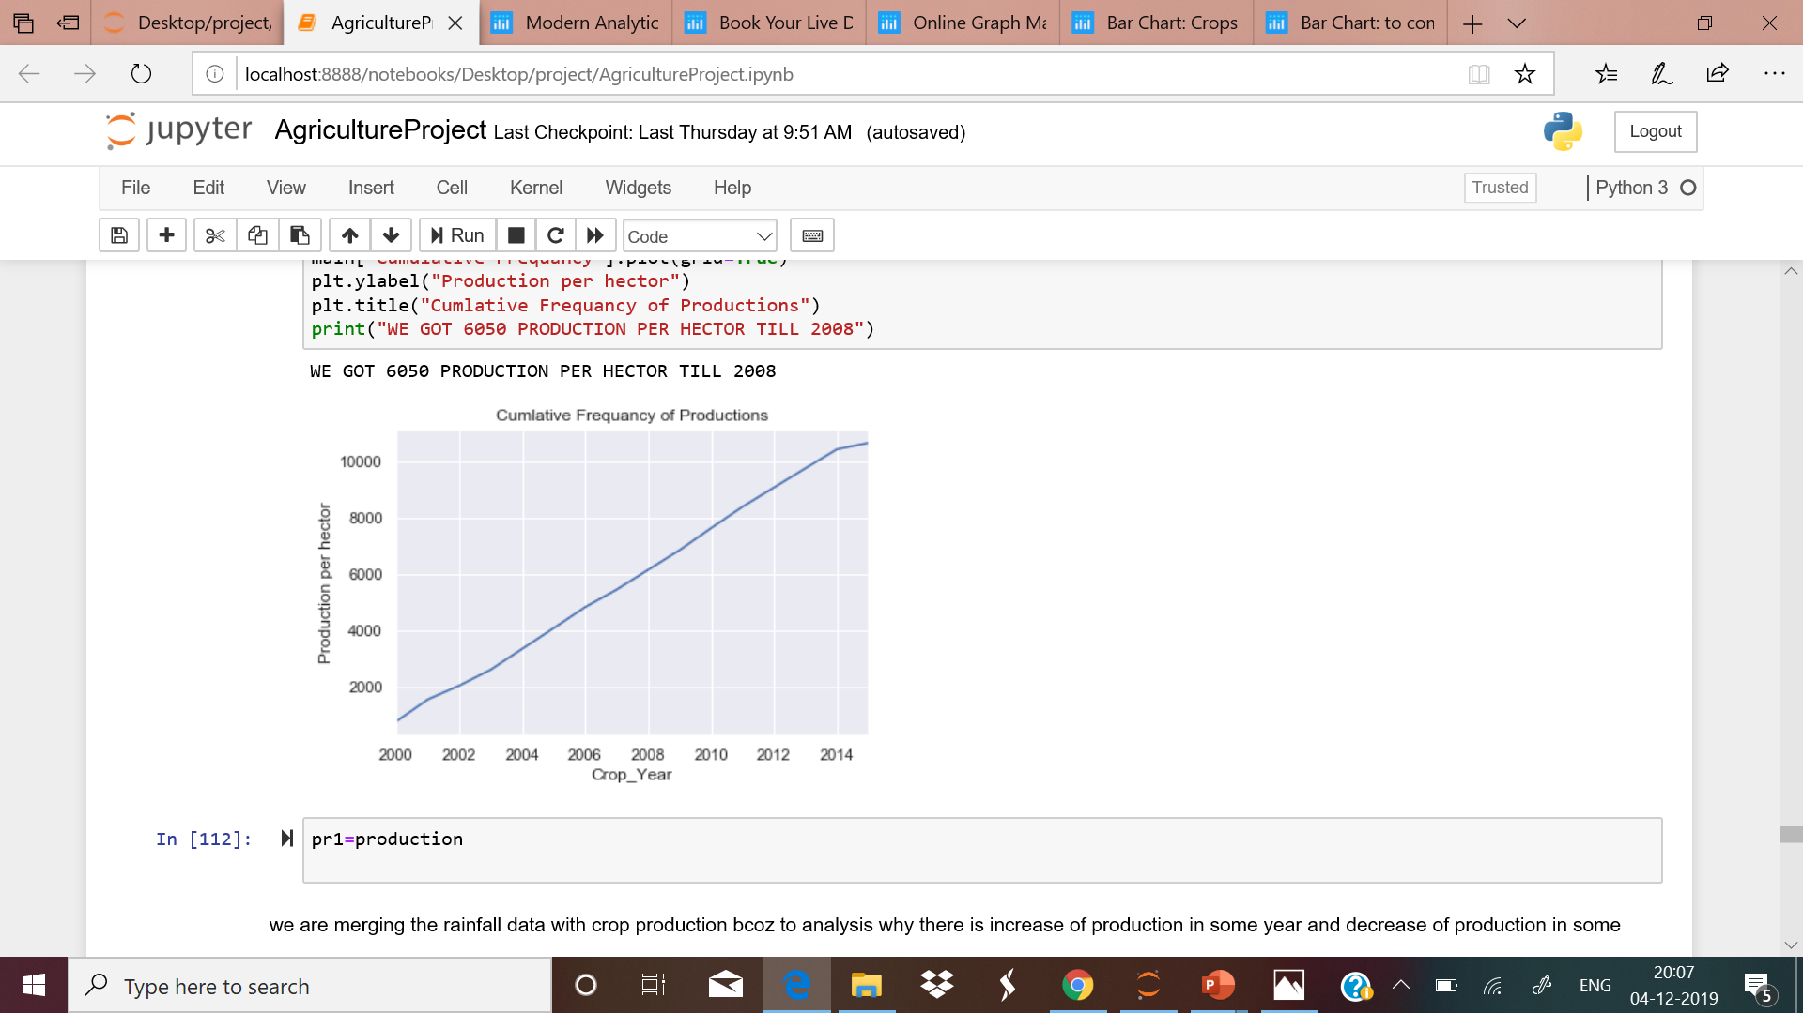
A 95% confidence interval is a range of values that you can be 95% certain contains the true mean of the population. This is not the same as a range that contains 95% of the values
Confidence interval at 95% level :(m,m-h,m+h)
(10.754890396935291, 10.68710086946601, 10.822679924404573)
The rainfall data is bimodal.
This is mean and standard deviation of rainfall(10.755, 2.2307)
Probability of Rainfall less then 200 cm is 1.0
There is 9.01% of chance of having rainfall equal or less then 200 cm rainfall

Slide 25
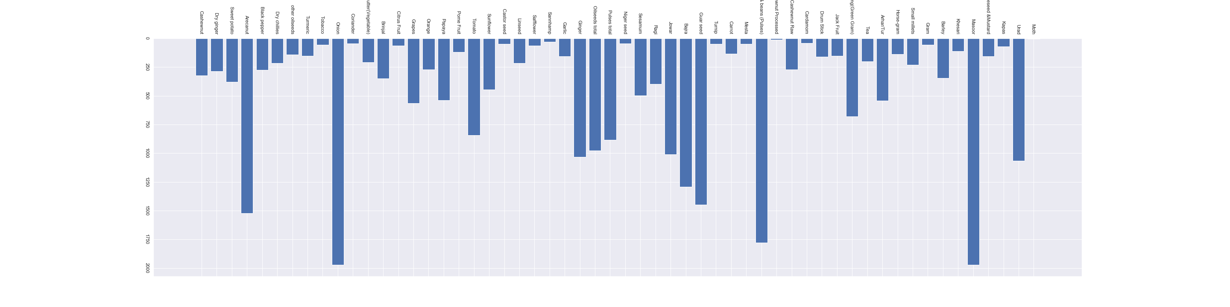
This is the production of crop which is produced whole year and the production is b/w 0-2000 per hector . in this criteria Production of Onion is Highest. then production of our pulses is 2nd highest.

Slide 26
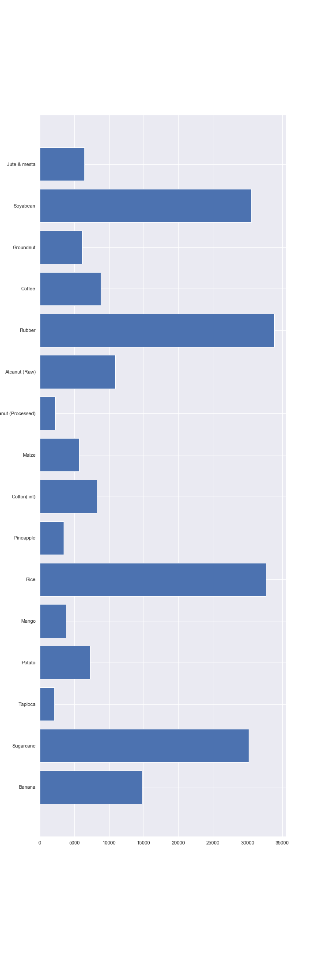
This is the production of crop which is produced whole year and the production is b/w 2000-35000 per hector . in this criteria Production of we produces Soybean , Rubber , Rice , Sugarcane as highest producers

Slide 27
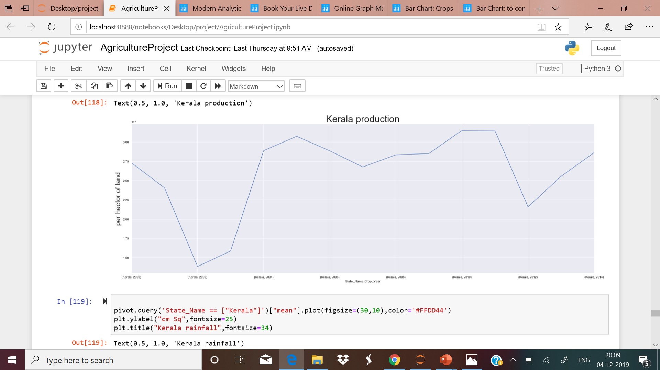
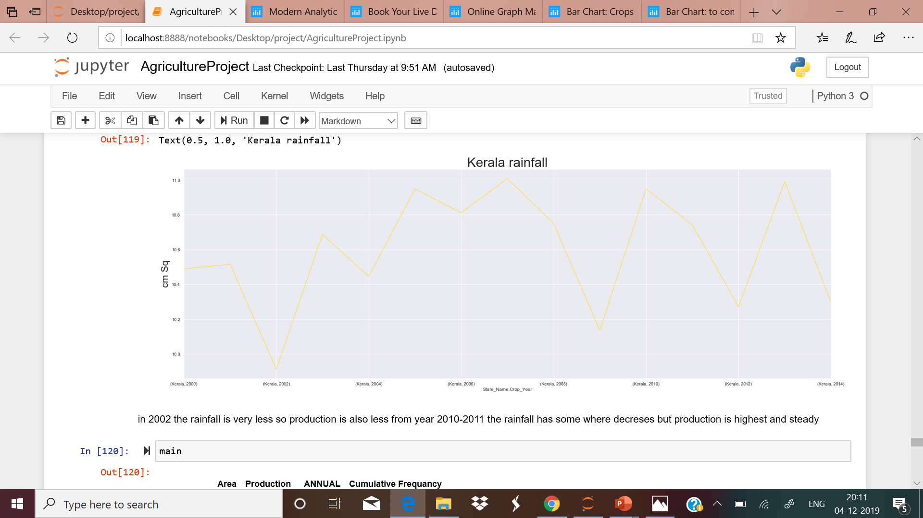
Kerala has maximum production in year 2010
In 2002 the rainfall is very less so production is also less from year 2012 the rainfall has some where decreases but production is decreased.

Slide 28
THANKYOU.

